Slide 1



DESIGN AND STIMULATION OF COMPACT MONOPOLE ANTENNA FOR UAV APPLICATION
BY:
RUBAA B

Slide 2
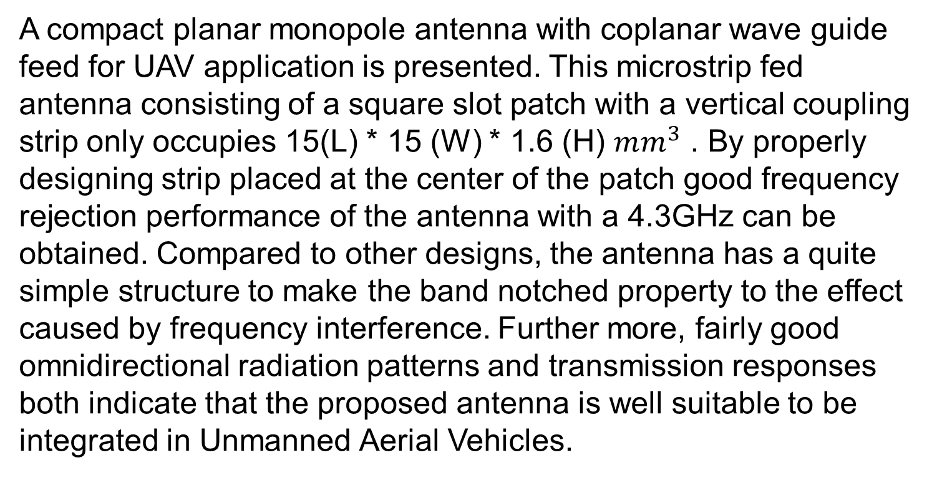
ABSTRACT

Slide 3
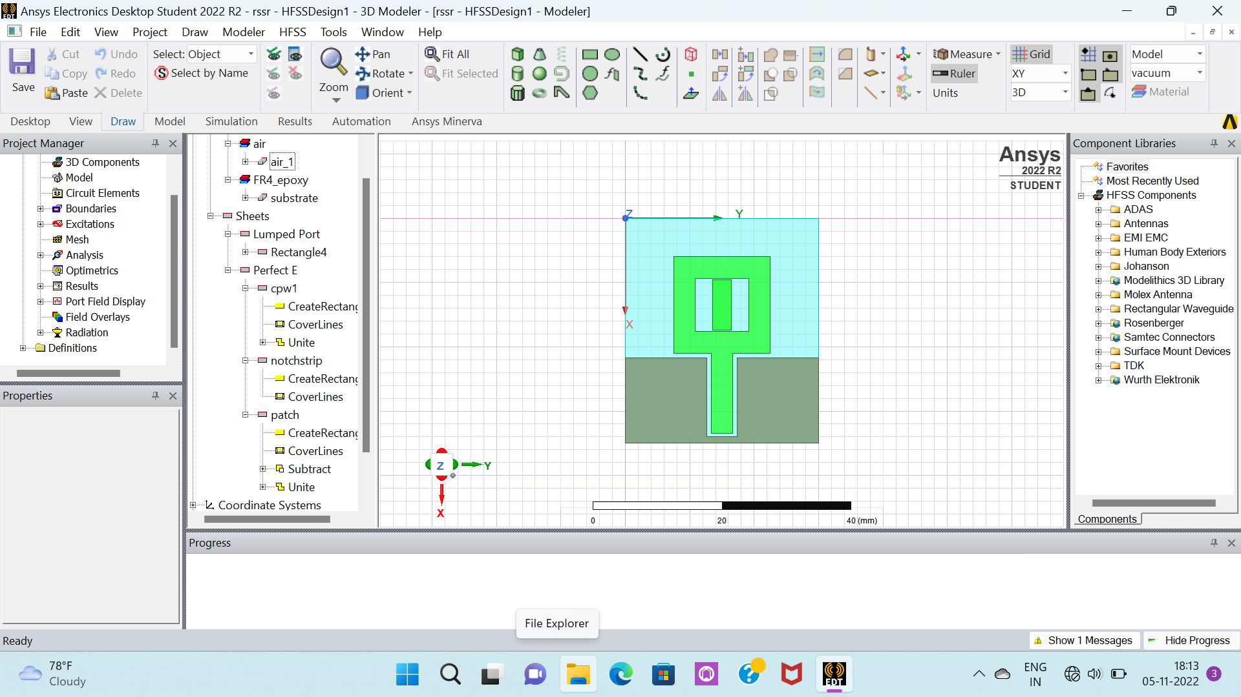
OBJECTIVE
To Design a Compact Monopole Antenna using High Frequency Structure Simulator(HFSS) for UAV applications.

Slide 4
ANTENNA
Antennas are key components of any wireless system.
An antenna is a device that receives or transmits electromagnetic waves.
An antenna is a one type of transducer that converts electrical energy into electromagnetic energy in the form of electromagnetic waves.
Antennas are required by any radio receiver or transmitter to couple its electrical connection to the electromagnetic field.

Slide 5
DESIGN PROCEDURE USING HFSS
Select the substrate to assign material.
By using the dimensions, design the required shape of the antenna.
Assigning Boundaries and Excitations.
Solution setup.
Analyze the results.

Slide 6
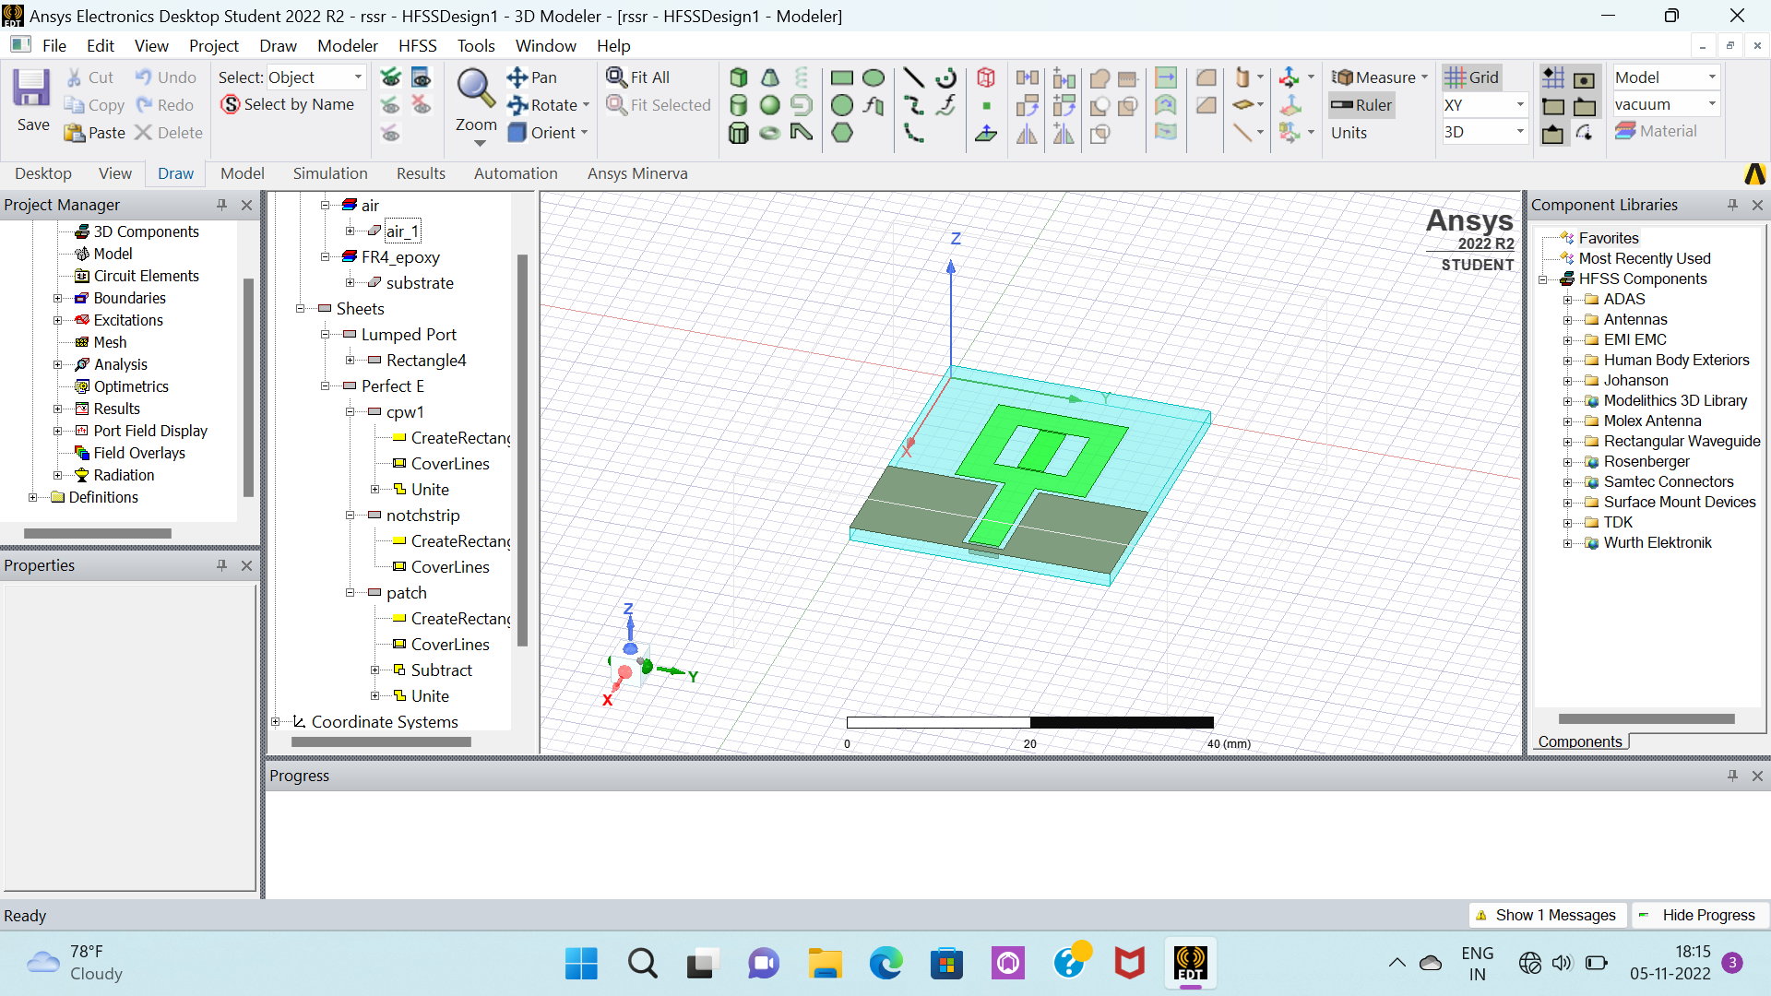
MODEL OF THE ANTENNA

Slide 7
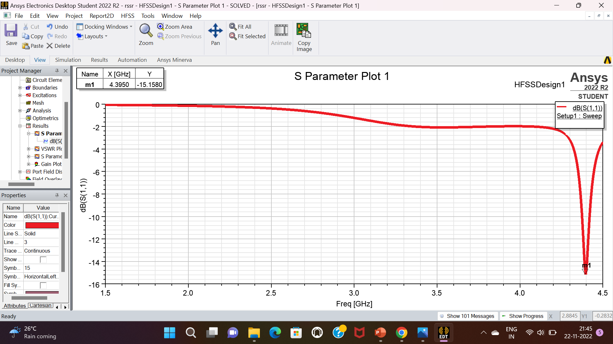
RESULTS S PARAMETER

Slide 8
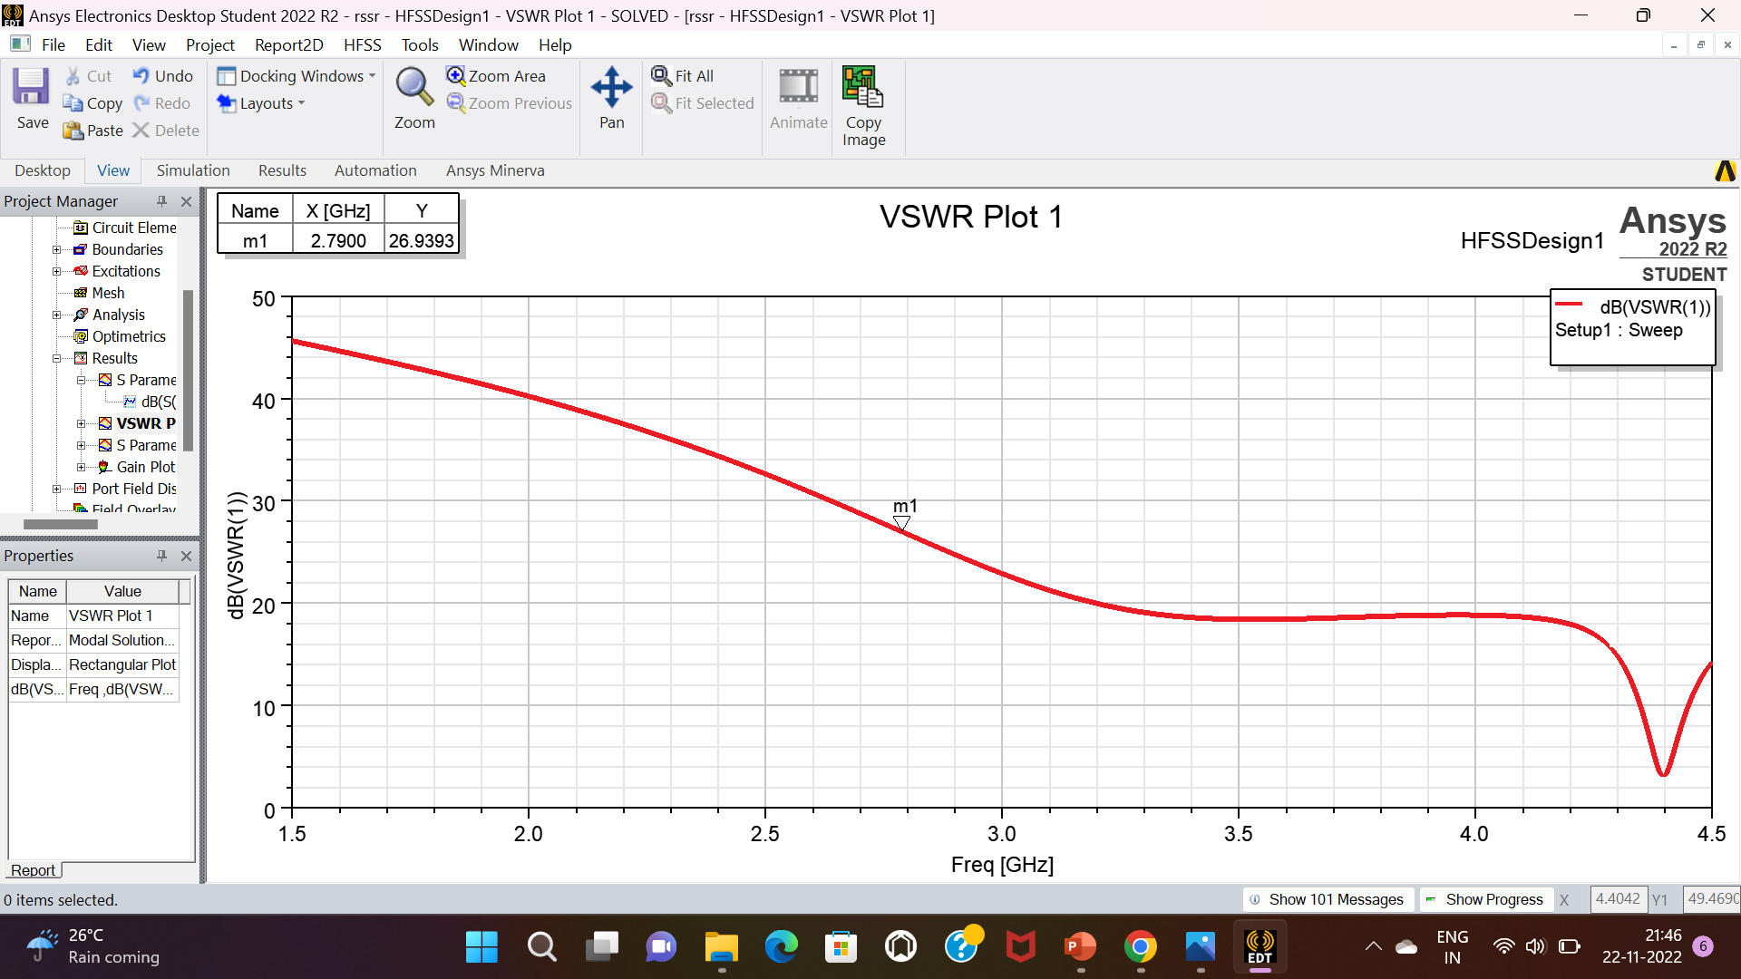
VSWR

Slide 9
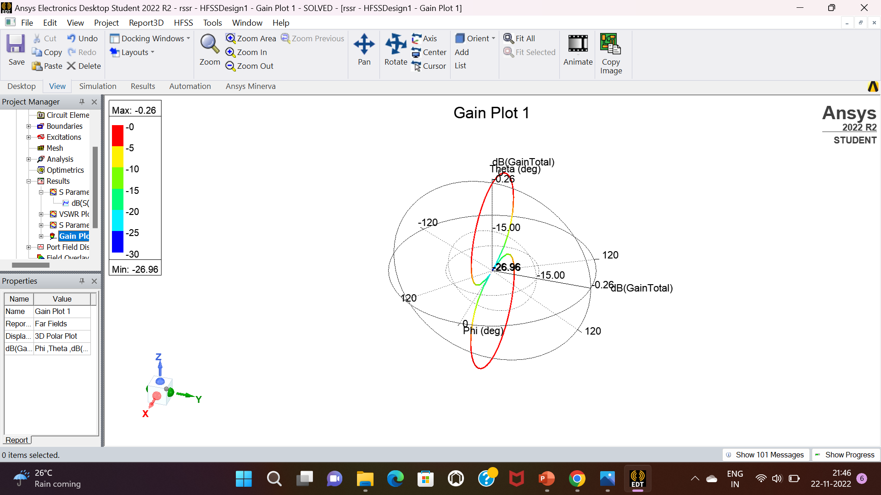
GAIN

Slide 10
UAV APPLICATION
Antennas are the most important electronic components of any UAV for they allow the vehicle to transmit information and to receive information from other systems, as well as the people on the ground.
ADVANTAGES IN UAV
Reduced volume and lighter structures.
Suitable for use in planar arrays.
Easy to adapt to different surfaces for mounting, if the substrate is flexible.

Slide 11
REFERENCE
[1] R. Zaker, C. Ghobadi, and J. Nourinia, “Bandwidth enhancement of
novel compact single and dual band-notched printed monopole antenna
with a pair of L-shaped slots,” IEEE Trans. Antennas Propag., vol. 57,
no. 12, pp. 3978–3983, Dec. 2009.
[2] H.-J. Zhou, B.-H. Sun, Q.-Z. Liu, and J.-Y. Deng, “Implementation
and investigation of U-shaped aperture UWB antenna with dual band-
notched characteristics,” Electron. Lett., vol. 44, no. 24, pp. 1387–1388,
Nov. 2008.
[3] J.-W. Jang and H.-Y. Hwang, “An improved band-rejection UWB
antenna with resonant patches and a slot,” IEEE Antennas Wireless
Propag. Lett., vol. 8, pp. 299–302, 2009.
[4] T. Dissanayake and K. P. Esselle, “Prediction of the notch frequency
of slot loaded printed UWB antennas,” IEEE Trans. Antennas Propag.,
vol. 55, no. 11, pp. 3320–3325, Nov. 2007.

Slide 12



